Slide 1
COMP1003 – Algorithms, Data Structures and Mathematics Session 16 Types and their Implementation in Memory
Thomas Wennekers
University of Plymouth

Slide 2
Main Ideas
Algorithms are independent of an implementation in a programming language or a hardware target …
… but hardware provides constraints on data types and on how efficient they can be.
An awareness of these restrictions is required for optimal size and speed of code

Slide 3
Outline
Number types and their representation
Strong & weekly typed programming languages
Arrays, collections, and their representation
Values, addresses, references, and pointers

Slide 4
Number Types
and their representation in memory

Slide 5
Mathematical Numbers (N, Z, Q, R)
Mathematics defines different sorts of numbers
N – the natural numbers 0, 1, 2, 3, …
Z – all integer numbers … -3, -2, -1, 0, 1, 2, …
Q – the rational numbers p/q p,q in Z
R – the real numbers 3.14152365
In school you learned what 3*5.2+7 means

Slide 6
Bad News
A Computer can not implement a single one of these sets, because they are infinite
Registers can not hold arbitrary large numbers.
Operations can lead out of the allowed range.
Real number representations are inaccurate.

Slide 7
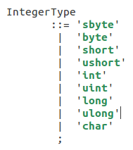
Integer Types in C#
These types differ in how many bits they use to store a number and in whether or not the numbers are signed or unsigned.

Slide 8
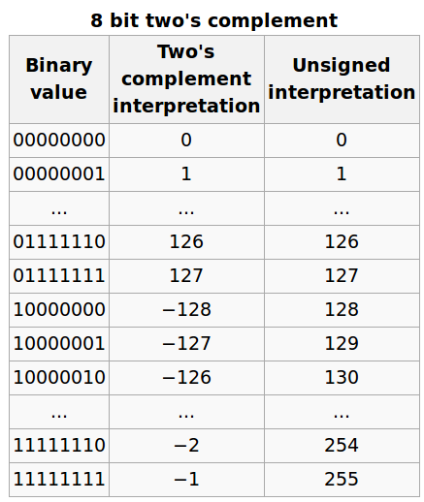
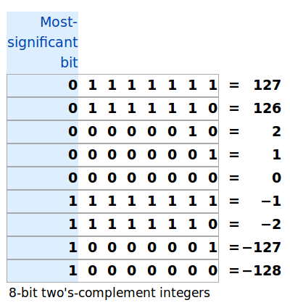
8-bit Integers (“characters”, “bytes”)

Slide 9
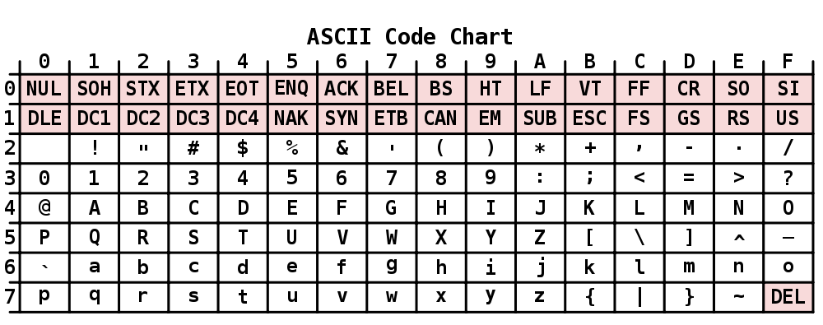
Note: Characters are Integer Types The ASCII Conversion Table
Note: ASCII is getting increasingly replaced by Unicode (UTF8/16), which uses 1 to 4 bytes.

Slide 10
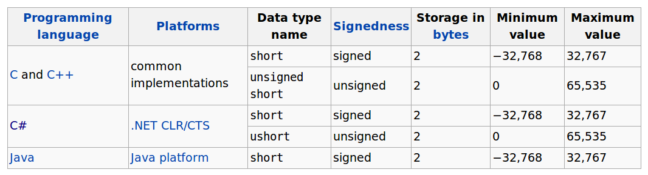
Short Integers

Slide 11
int, long, long long
byte <= short <= int <= long <= long long
int : typically 4 bytes
long: may or may not be bigger than int
long long isn't often supported as syntax
C# : int = 4, long = 8 bytes (64 bits)
Note: bit- and byte order is “usually” from right to left; most significant bits/bytes are left; least significant bits/bytes right

Slide 12
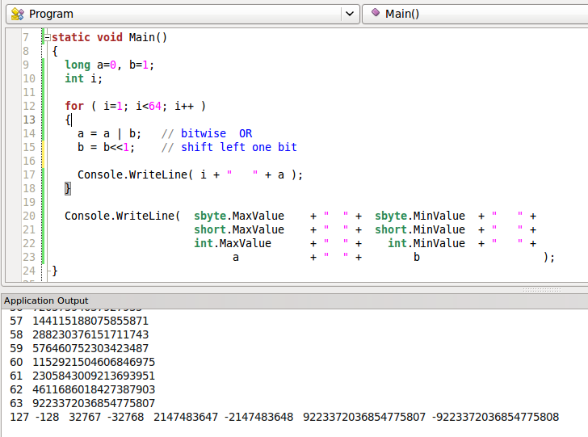
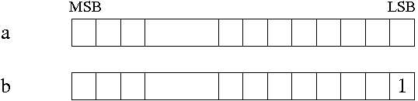
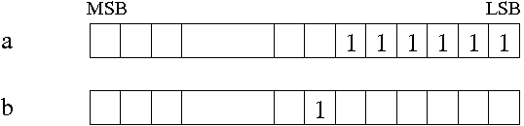
C# Integer Sizes and bit-Operations

Slide 13
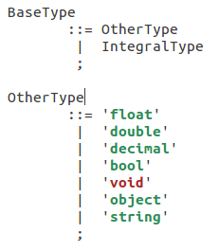
C# Basic Types
float, double, decimal
represent real numbers
bool – boolean values “true” or “false”
void – no type, untyped
string – character sequences
object –most basic C# type; → see OOP

Slide 14
Fixed-Point Numbers
Approximation of real numbers with fixed (maximal) number of digits after the decimal point:
1.234 890.32 -12
Can speed up mathematical calculations; especially on machines without floating point unit (e.g. (old) hand-held or embedded devices)
Not explicitly supported by C#

Slide 15

Floating Point Numbers
Another representation of real numbers
-1.245 x 10³² 0.123 x 2¹²³ 123.4 x 10⁻²²
Can cover a much larger range than fixed-points
need more storage; are potentially less precise
need rescaling of the exponent
are supported by floating point units

Slide 16
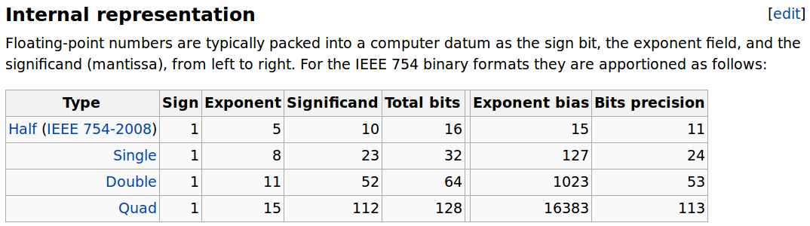
Floating Point Types
Note: “Quad” = “decimal” in C#

Slide 17
Strong versus Weak Typing
In C#, C/C++, Java and other programming languages every variable needs a type, specific and fixed (and every function or method, too)
Conversions between different types or their combination in expressions are often severely restricted. These are strongly typed languages.
Weekly typed languages allow for more or less free implicit conversions.
Strong typing allows for more thorough checks during compilation and more efficient code.

Slide 18
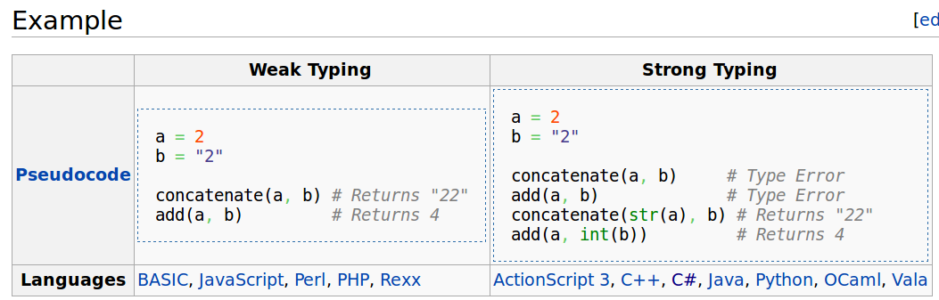
Example: Strong vs. Weak Typing

Slide 19
Implicit and Explicit Conversions
Implicit conversions change types or values according to rules built-in to a programming language / run-time environment.
Explicit conversions use keywords to specifically request conversions.
Conversions cost time!
C# allows only for quite few implicit conversions
… but the user can define conversion operators

Slide 20
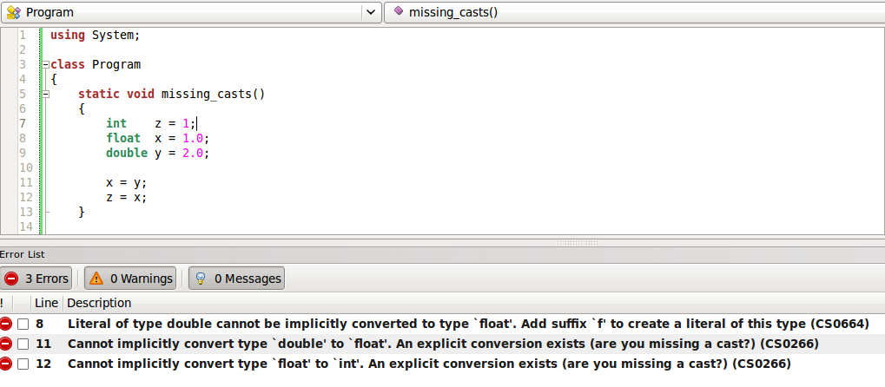
C# Example – “Buggy” Code
Note “1.0” is by default a double! It can't be implicitly assigned to a float or an integer.

Slide 21
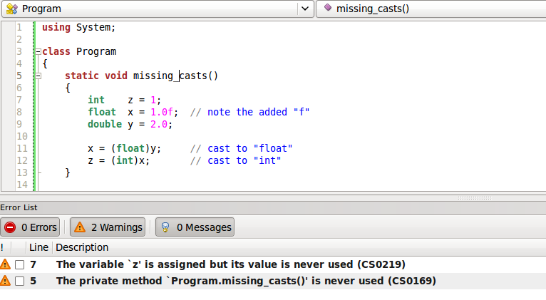
C# Example – “Correct” Code
the “casting” of values can cost precision

Slide 22
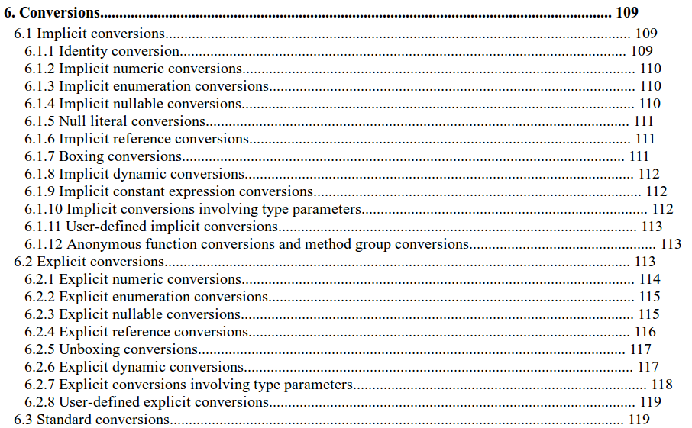
C# Conversions (from official MSDN Specification)

Slide 23
Arrays, collections, and their representation in computer memory

Slide 24
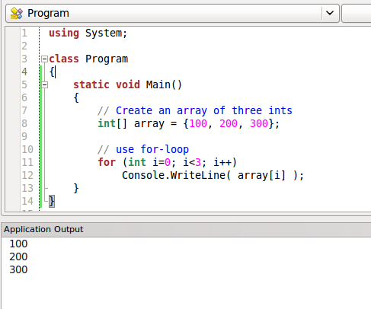
Arrays in Code

Slide 25
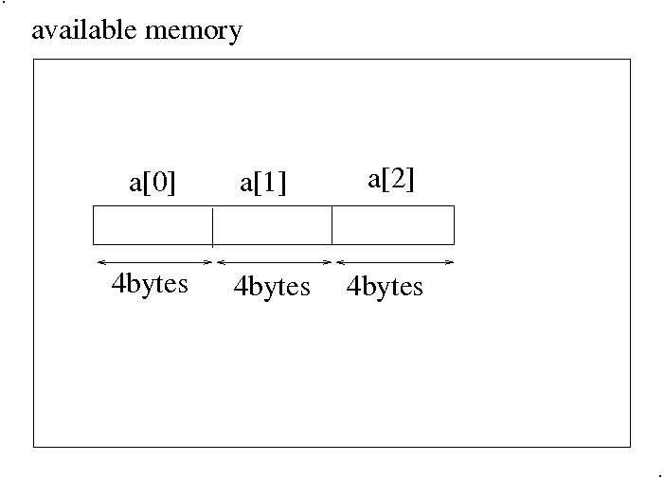
int (4 bytes) Array in Memory
Note: In element accesses, a[i], the compiler keeps track of the element size

Slide 26
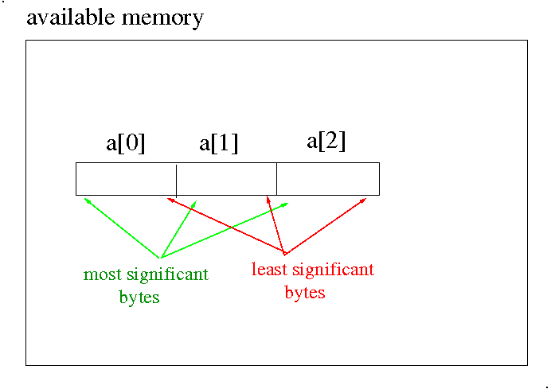
Integer Array in Memory
Note: Byte order can differ!

Slide 27
Array Representation
Array elements all have the same size in memory; the size of their basic type
Elements are typically consecutively laid out in memory starting at some location, with higher indexed elements at higher memory locations
Bracket operator [ ] accesses array elements:
A[i] accesses memory space at the byte with number i * sizeof (<type>) starting from the beginning of the array A

Slide 28
Higher-dimensional Arrays?
Data is stored linearly in memory: elements with the most right index are stored first, then the next dimension to the left, and so on
e.g., for a two-dimensional array the first row is stored first, then the second, and so on.

Slide 29
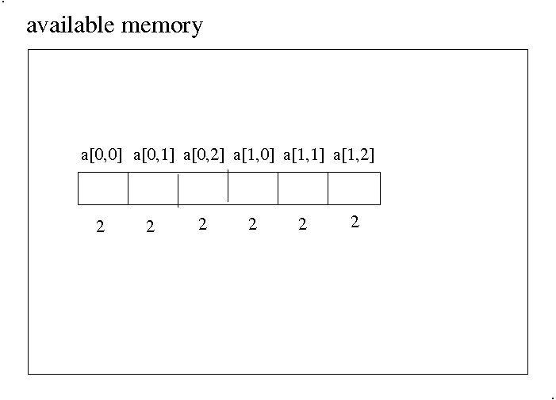
2D Array in Memory

Slide 30
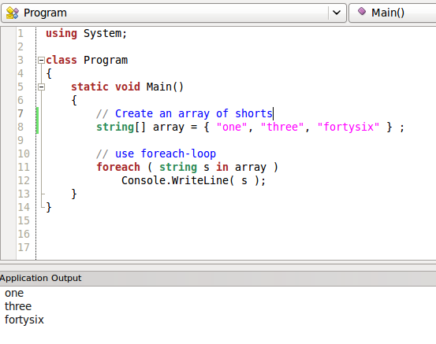
String Arrays?
Elements have different length??

Slide 31
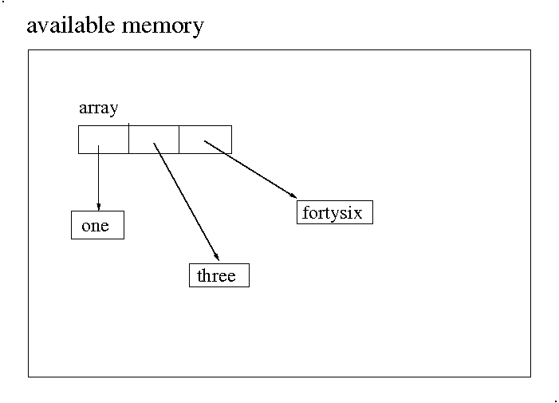
String Arrays
The array stores fixed size “references” to the strings.
→ Later more about references

Slide 32
Efficiency Notes
Code should not depend on the
layout of data in memory
Use [ ] to access elements
However: code efficiency depends very much on memory layout
CPUs can load linear memory segments quickly
The CPU cache allows very fast operation
Badly aligned data can cost a factor of 10 in speed

Slide 33
Collections

Slide 34
Collections
Often data in a program can be organised into logical sets
For example a student record could consist of
string first_name
string last_name
int age
int student_id

Slide 35
(plain old) Structures or Records
have a name
contain a collection of fields for values
do not contain methods/functions
can be nested (i.e., a field can be a struct again)
access of fields uses the dot-operator “.”

Slide 36
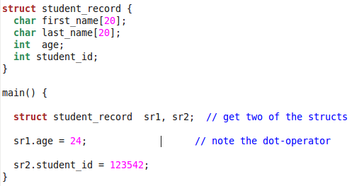
struct (in C)

Slide 37
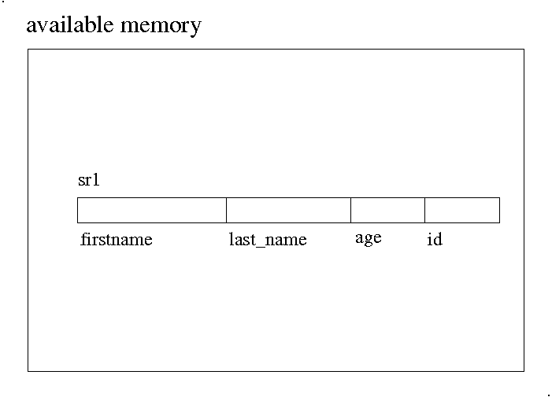
Structure Layout in Memory
Note: The layout can have “holes” (e.g., if elements must fall on word-boundaries)

Slide 38
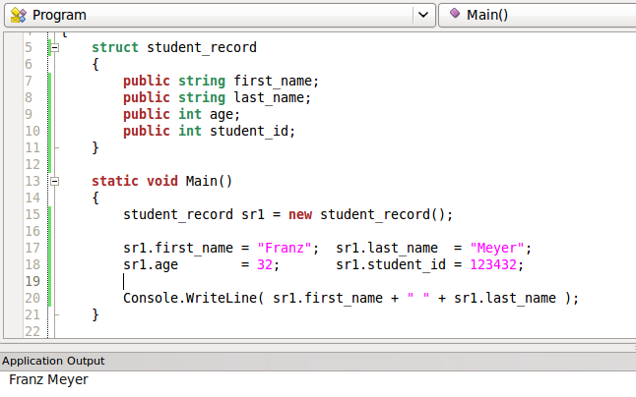
struct (in C#)

Slide 39
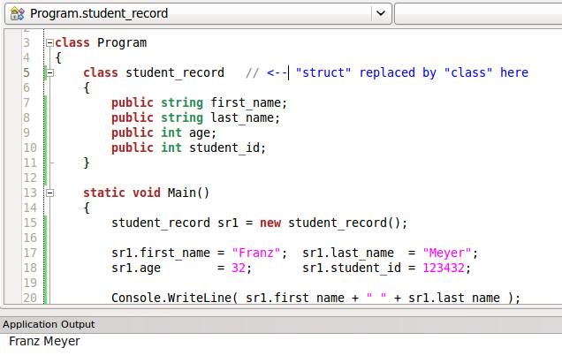
Classes are more common in C#
Classes are out of the scope of COMP1003

Slide 40

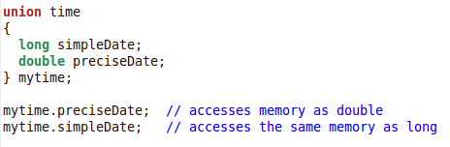
Other topics, not covered in detail
Differences between structs and classes → see modules about object oriented programming (OOP)
enum types: lists of tags
unions: access the same memory as different types

Slide 41
Values, references, addresses and pointers

Slide 42
String Arrays in Memory
The array stores fixed size “references” to the strings.
What are references ???

Slide 43
Addresses
Variables occupy memory space
Memory cells (“bytes”) available to a program during run-time are linearly enumerated
The number where a variable starts in memory is its address; it uses a number of bytes from there (2 for a short, 4 for an int and so on)

Slide 44
Addresses
Variables occupy memory space
Memory cells (“bytes”) available to a program during run-time are linearly enumerated
The number where a variable starts in memory is its address; it uses a number of bytes from there (2 for a short, 4 for an int and so on)
Some programming languages (C/C++/C#) allow to explicitly deal with addresses …
… but this is now considered unsafe and should be avoided!

Slide 45
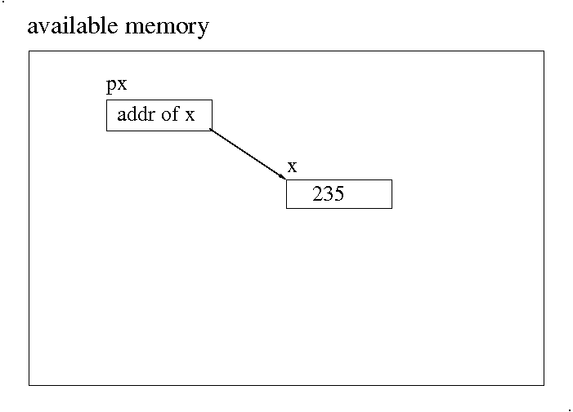
Address and Pointer Schematic
Note: “px”, “x” and the arrow do not exist in memory

Slide 46
Addresses and Pointers (in C)
The address operator “&” applied to a variable returns its “physical” address
int x = 235; // int variable with value 235
int *px = &x // pointer to int is set to addr. of x
The address is “dereferenced” using the “*” (star) operator; this returns the value at the target address
* px = 22; // reset x from 235 to 22

Slide 47
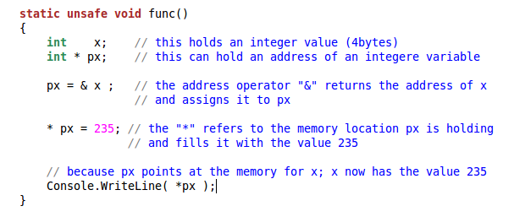
Addresses and Pointers in C# & and * operators

Slide 48
References
C# code (and code of other languages) can dynamically move variables in memory.
Their address is not guaranteed to be constant
Therefore C# uses “references”
The “new” operator returns a reference to an object (this may be an address internally but should not be handled as one).

Slide 49
Many of the data types and algorithms considered in later lectures will make excessive use of "pointered" structures that use references

Slide 50
Address and Pointer Schematic

Slide 51
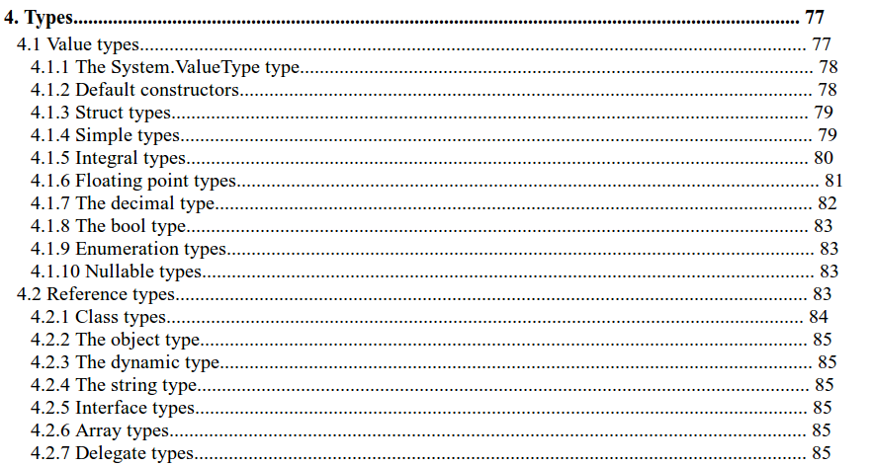
C#- Value- vs. Reference-Types (from official MSDN Specification)

Slide 52
Outcomes
Insight into different data types, how they are implemented on computers, and laid out in memory.
Understanding of variables, values, addresses, pointers, and references.

